Slide 1
AUCTUS: The Grocery Store Analysis
DOM 304: Contemporary Business Analytics

Slide 2






THE TEAM
Aamaya Kumar
Rahul Madan
Hriday Pradhan
Mehak Agrawal
Kathyayani Rana
Eshaan Sharma

Slide 3
1
Problem Statement
2
Problem Description
3
Understanding the Data
4
Data Preparation
5
Model Building and Evaluation
6
Deployment
7
Recommendations & Conclusion
8
Acknowledgement

Slide 4
PROBLEM STATEMENT
The Grabbo convenience store at Shiv Nadar University seeks to boost sales. We’ll perform Market Basket Analysis. This process identifies the purchasing patterns of customers by finding associations between the different items that customers place in their “shopping baskets”. Retailers and marketers will benefit from the finding of this kind of relationship since it will provide them insight into which products people regularly purchase together, which will help them design marketing strategies.

Slide 5
PROBLEM DESCRIPTION
INCREASED PROFITS
INCREASED TRACTION
GREATER PRODUCT MIX
Our analysis has a number of advantages that can help our in-house convenience store. They are as follows:
When products are placed in locations with most traction, they are sold more. This will increase the profits of Grabbo.
If Grabbo sells products that are not available throughout the campus, it will increase traction in their store premises.
By understanding the needs of the consumers through our model, Grabbo can increase their product mix.

Slide 6
APRIORI ALGORITHM
Apriori algorithm refers to an algorithm that is used in rule mining for frequent products sets and relevant association rules. Generally, the apriori algorithm operates on a database containing a huge number of transactions. For example, the items customers buy at a Convenience Store.
Apriori algorithm helps the customers to buy their products with ease and increases the sales performance of the particular store by suggesting combos which are mostly sold together.

Slide 7

BUSINESS UNDERSTANDING: ABOUT GRABBO
Conventional stores are a one-stop-shop for all households.
Grabbo, the conventional store of Shiv Nadar University, is the only one on a 297 acre residential campus. Students, faculty and staff pay visit to the store for their daily needs that include snacks, drinks, packaged food items, daily grocery and more.
Grabbo's invoice data set can help us analyse various aspects to increase profitability of the business.
The invoice data can help us correlate the reasons behind frequent purchases and group purchases along with ascertaining the most sold items.
With the help of the invoice data we aim to analyse, interpret and evaluate the combinations best sold together, strategic placement of products in the premise and strategic discounts that can help increase sales.

Slide 8
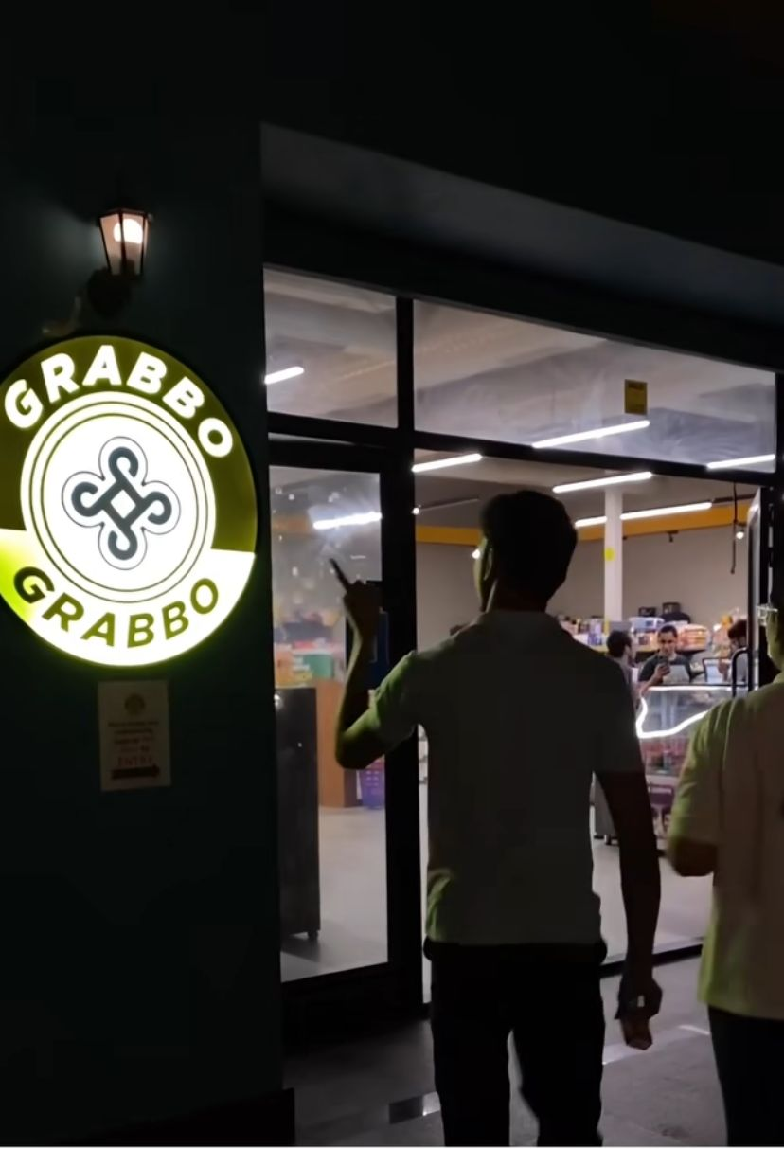
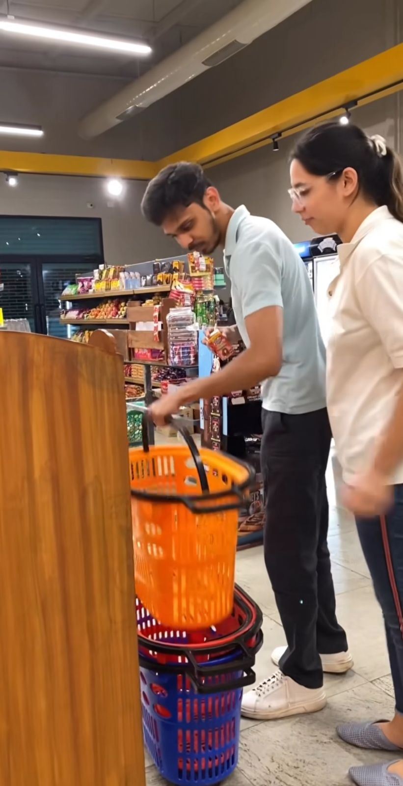
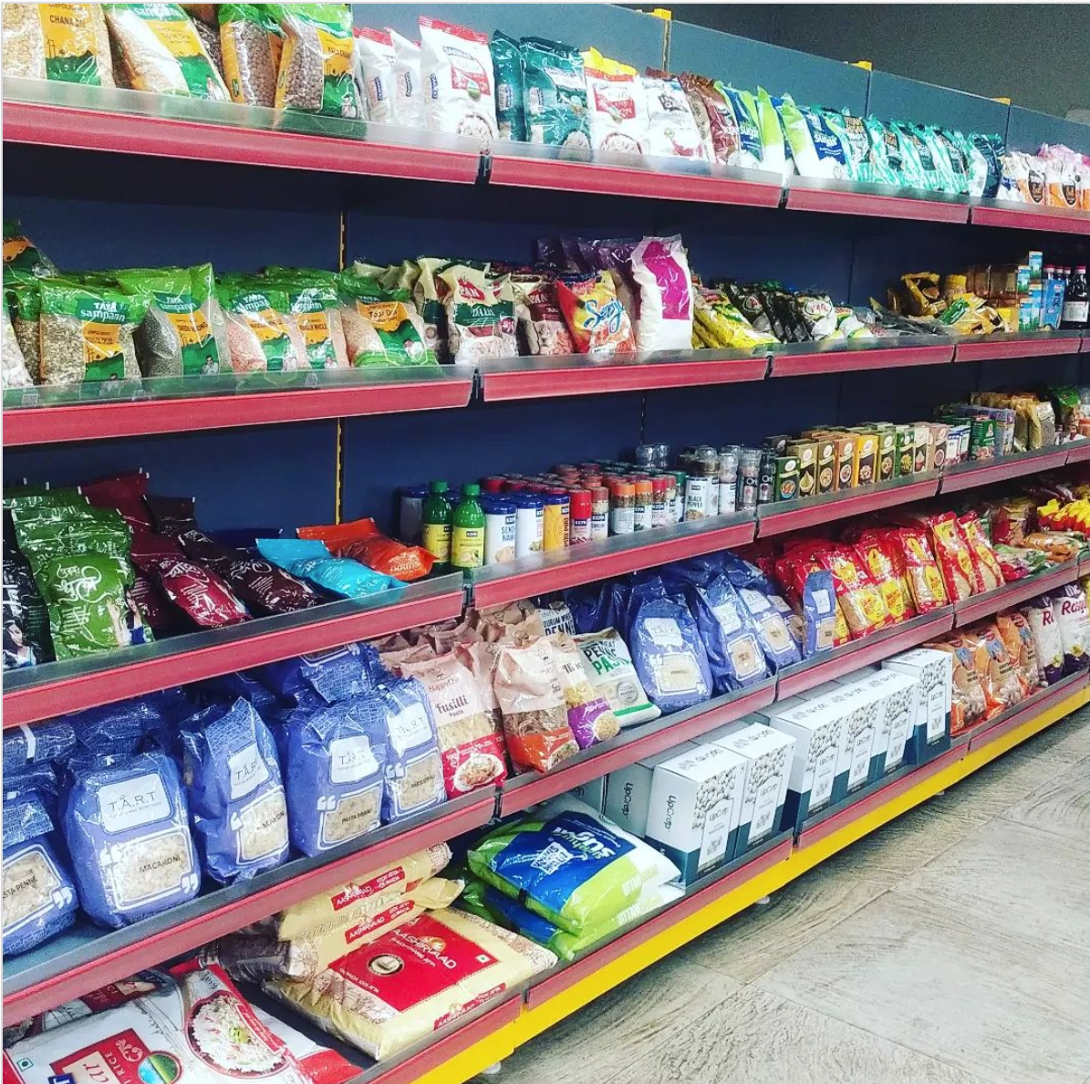
BUSINESS UNDERSTANDING: ABOUT GRABBO

Slide 9
BUSINESS UNDERSTANDING: GRABBO
6336
266557
90515
Total Unique Items
Total Data Points
Total Unique Bills

Slide 10
CONFIDENCE
SUPPORT
LIFT
Components of Apriori Algorithm
Confidence refers to the possibility that the customers bought both biscuits and chocolates together. So, you need to divide the number of transactions that comprise both biscuits and chocolates by the total number of transactions to get the confidence.
Support refers to the default popularity of any product. You find the support as a quotient of the division of the number of transactions comprising that product by the total number of transactions.
Lift measures the performance of a targeting model (known as an association rule) at predicting a specific outcome, compared with a random choice. Therefore, Lift is the ratio between target response and average response. That is to say that Lift is a ratio between confidence and expected confidence.

Slide 11
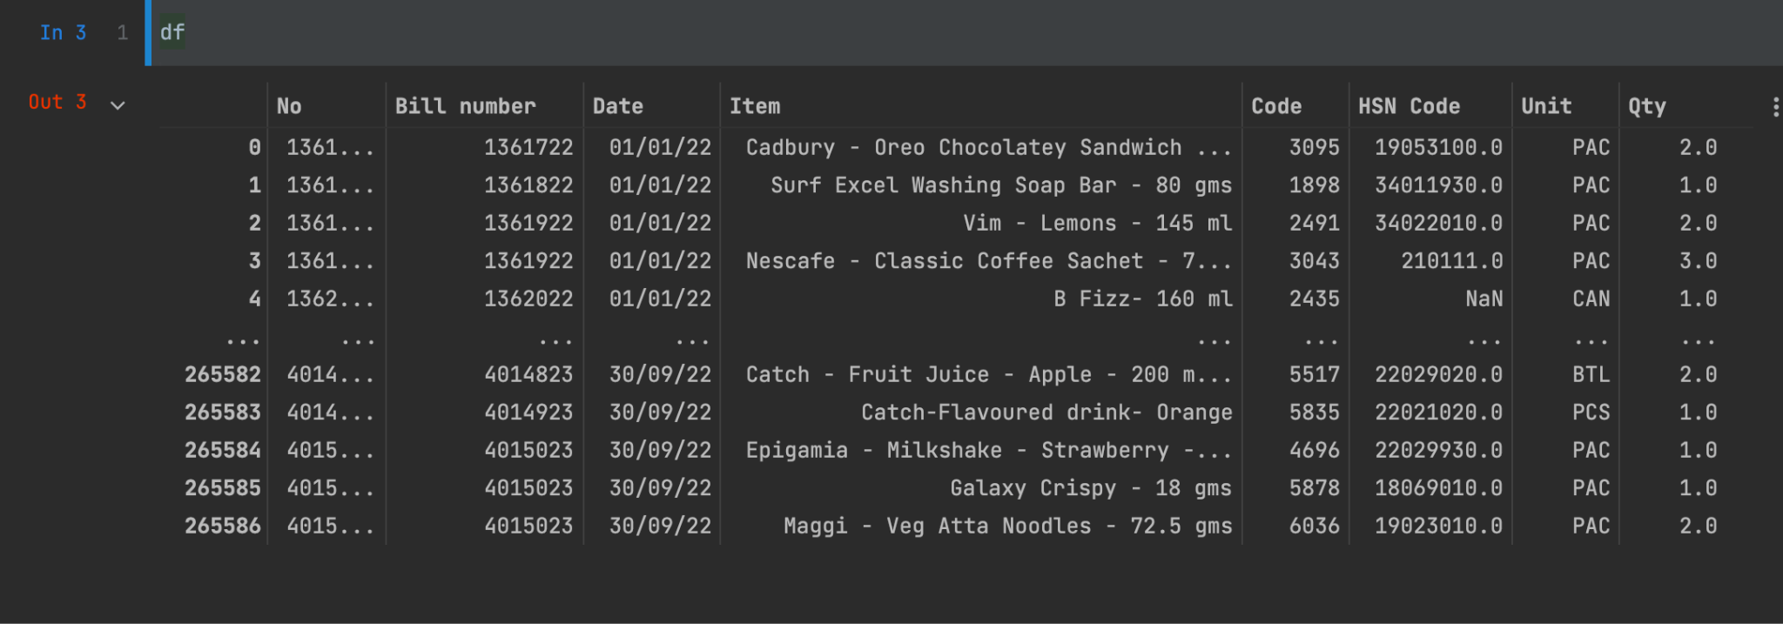
Understanding the Data
Details
We collected transaction data from Grabbo convenience store - SNU
Dates: August 2021 to November 2022
Total months: 15 months

Slide 12
Understanding the Data
COLUMNS (Total = 8)
No: string - Unique bill number for each financial year
(composition = <bill number>’\’<financial year>)
Bill number: integer - derived from ‘No’ by removing “/”
Date: Date - date of invoice in format DD/MM/YY
Item:string - purchased product name
Code: integer- unique product ID
HSN code: integer - Internationally recognized product codes
Unit: string(3) - unit of measure of item (eg. BTL for bottle, CAN for tin can etc)
Qty: float - quantity of that item purchased (eg. 0.9 Kg Apples, 1.0 Pepsi)

Slide 13
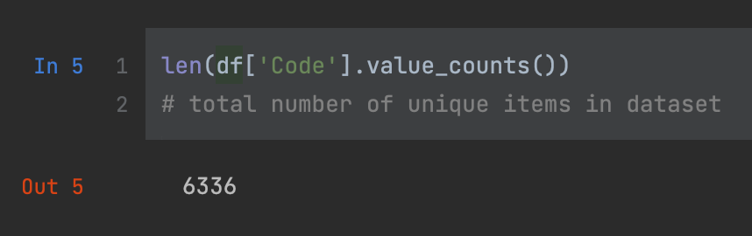
Exploratory Data Analysis
TOTAL NUMBER OF UNIQUE ITEMS IN DATASET = 6336

Slide 14
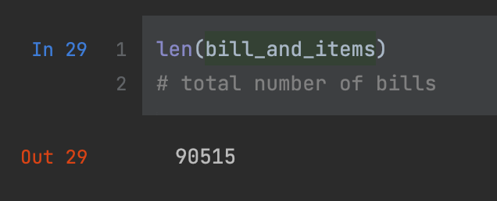
Exploratory Data Analysis
Total number of Invoices in data = 90515

Slide 15
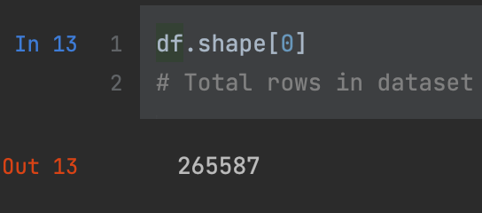
Exploratory Data Analysis
Total number of rows in data = 265587

Slide 16
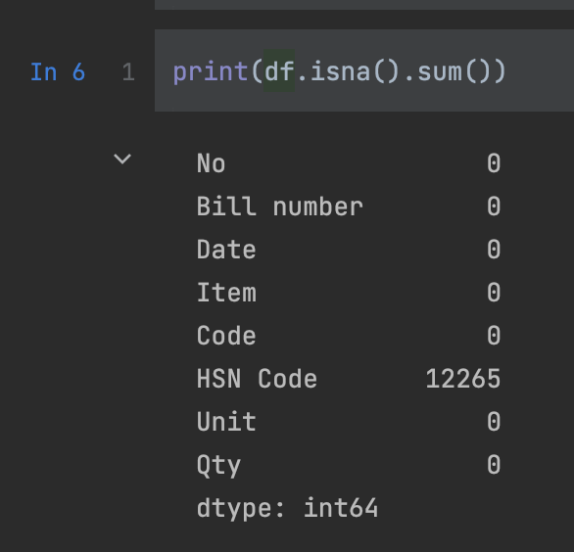
Exploratory Data Analysis
Null values in all columns

Slide 17
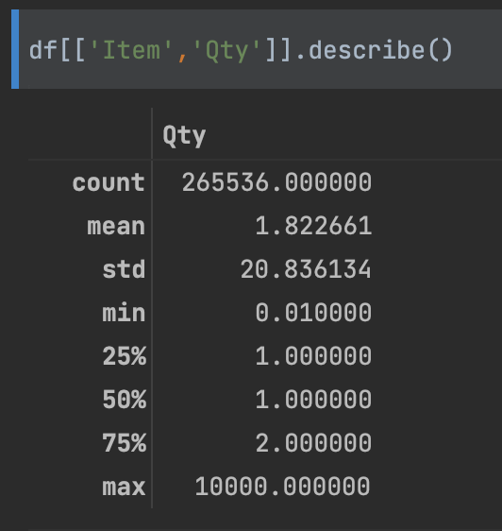
5 Number summary for Quantity of items purchased
5 Number Summary for quantity:
Min = 0.01 (Nestle creamer)
Max = 10000 (Bisleri 250ml)
Lower quartile = 1.0
Median = 1.0
Upper quartile = 2

Slide 18
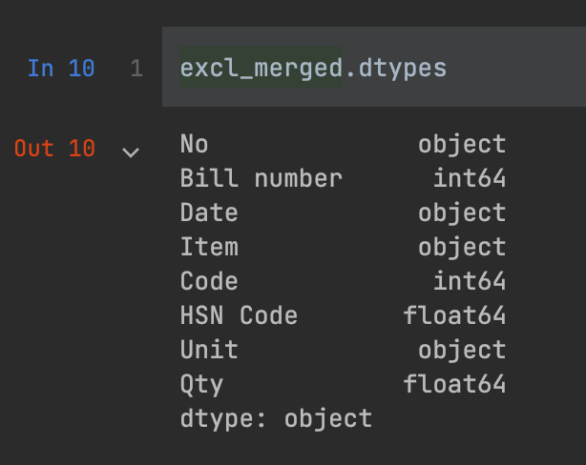
Data preparation
We created new column named ‘Bill Number’ which combines “No” and “date” to give a unique bill number for bills in 2021 and 2022.
Observed HSN code has null values using isnull() function
Removed - No, date, HSN code, unit and quantity from data as they are not required in Apriori algorithm
Changed data type of product code “Code” to int64
Removed null rows

Slide 19
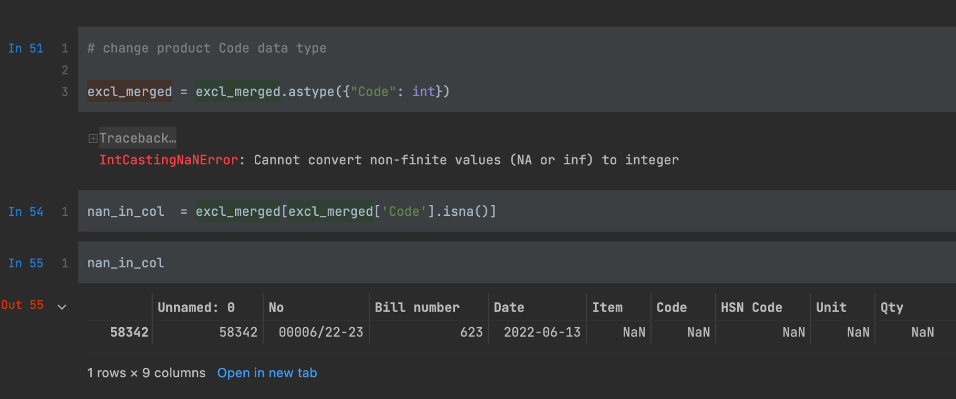
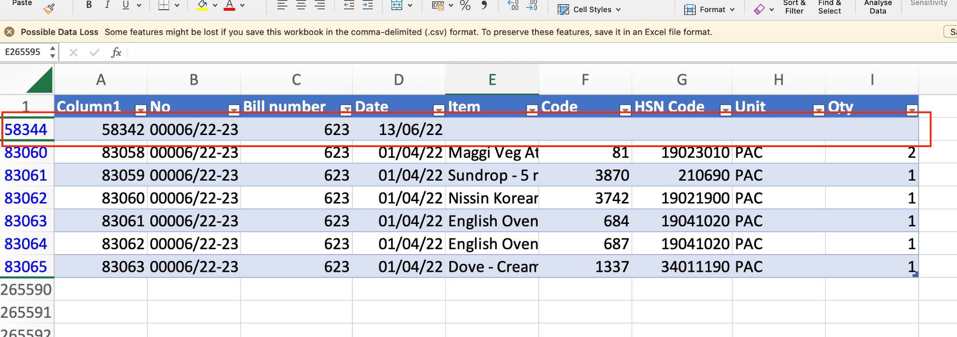
Challenges in data
Challenge: Due to nan value in 1 row, we were not able to change the data type of product code “Code”
Solution: We removed the row from data

Slide 20
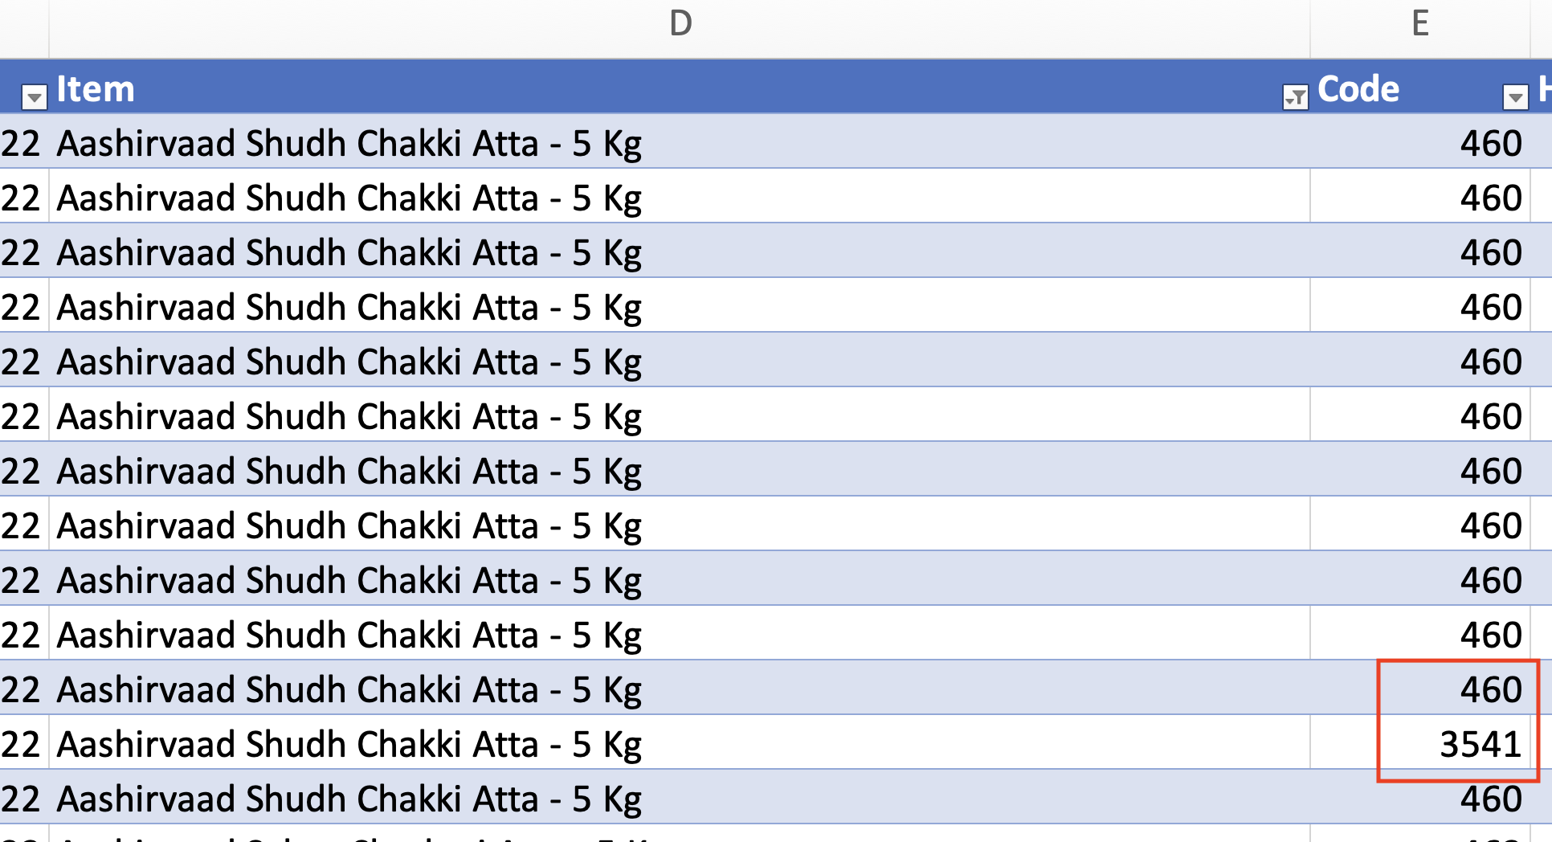
Challenges in data
Challenge: Items having same names are having different product code “Code”
Solution: similar product grouping using python

Slide 21
Similar product grouping
Results from Apriori Algorithm can be improved significantly by grouping similar/duplicate products into single product.
We used FUZZY STRING MATCHING in python to group similar item names into 1 category
Threshold for string match:
We used 80% similarity threshold for item names to be grouped together after manually looking at the results on different threshold values

Slide 22
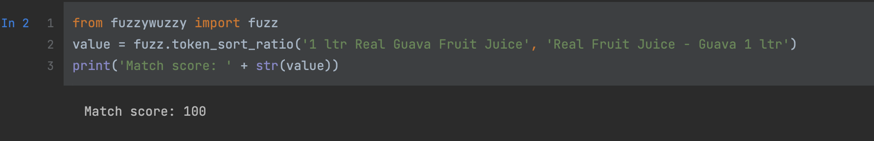
FUZZY STRING MATCHING IN PYTHON
Used for grouping similar/ duplicate items
Fuzzy string matching works on Levenshtein distance between strings. We used library named ‘fuzzywuzzy’ to get the similarity score between 2 strings.
We used fuzzywuzzy.sort_token_ratio which does not consider placement of words in the strings.
Eg. ‘Real Fruit Juice - Guava 1 ltr’ & ‘1 ltr Real Guava Fruit Juice’ would be assigned a score of 100 ie. full match.

Slide 23
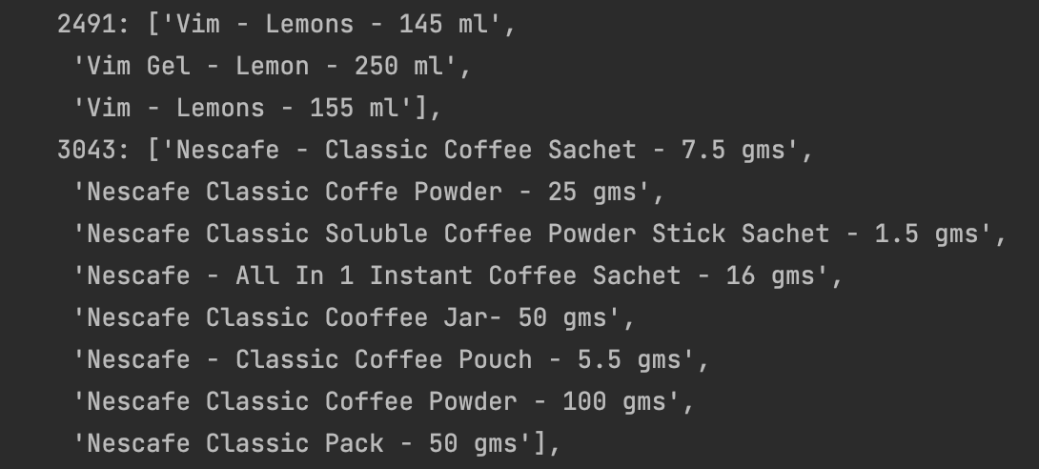
Example of grouped Items in data
Group 1
Group 2

Slide 24
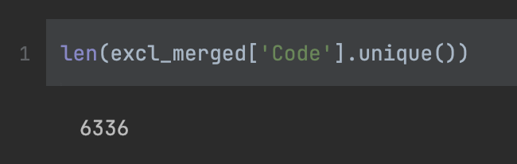
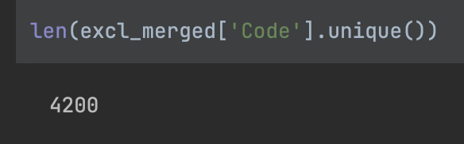
Result of grouping similar/duplicate items
Old number of unique Items in dataset = 6336
Similarity Threshold = 80%
New number = 4200
Reduction of 2136 items
34% reduction in unique items by grouping similar/ duplicate items.

Slide 25
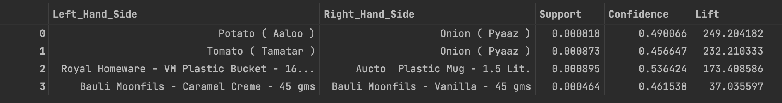
Association rules on different confidence and support values

Slide 26
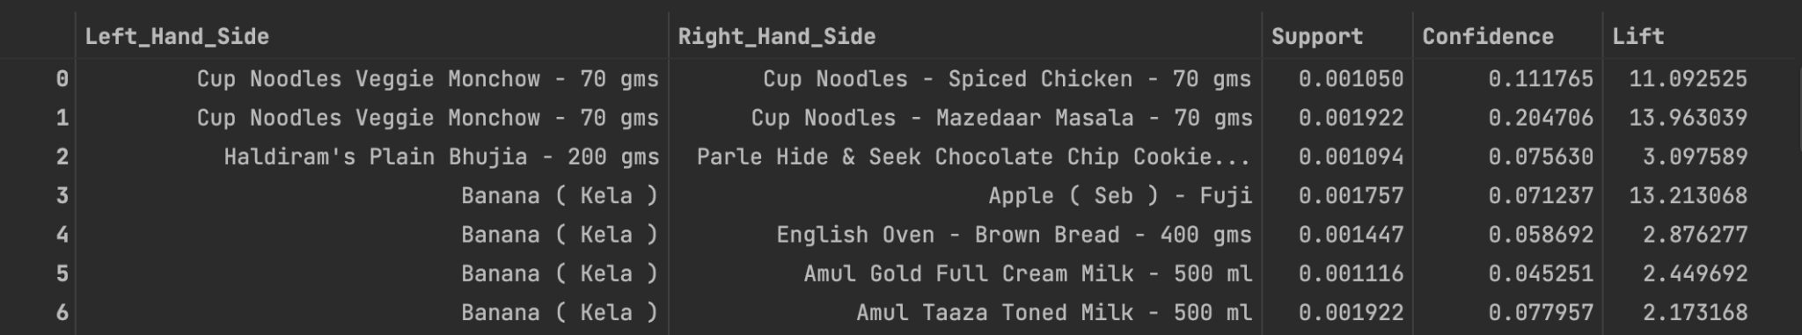
Association rules on different confidence and support values

Slide 27
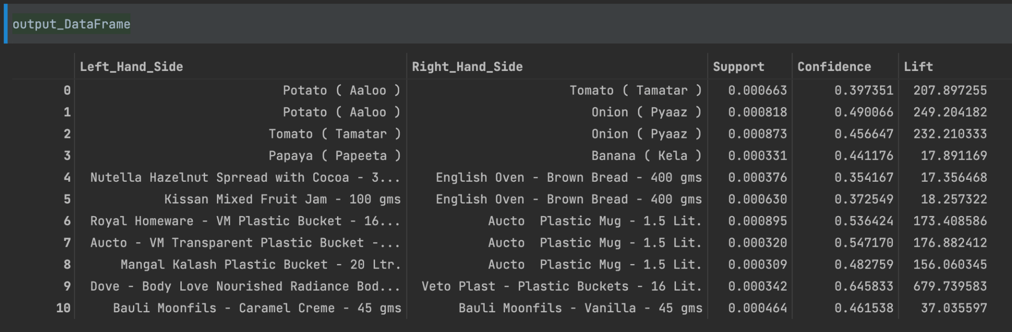
Association rules on different confidence and support values

Slide 28
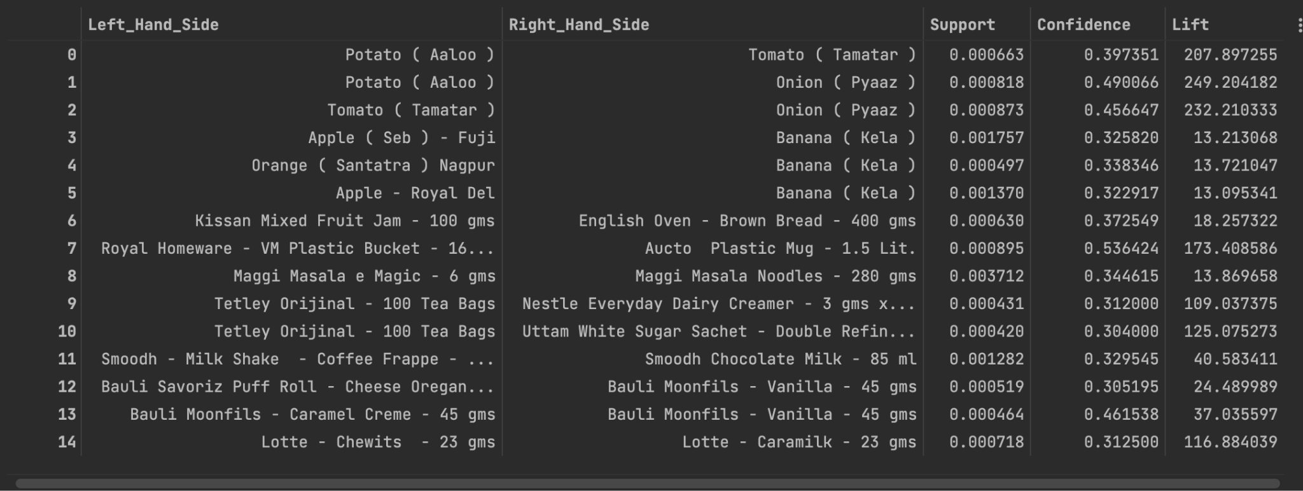
Association rules on different confidence and support values

Slide 29

All Association rules
We have stored all 2000+ rules retrieved from data analysis in a CSV file on GITHUB LINK HERE
We can apply filters according to our need and get the relevant association rules.

Slide 30
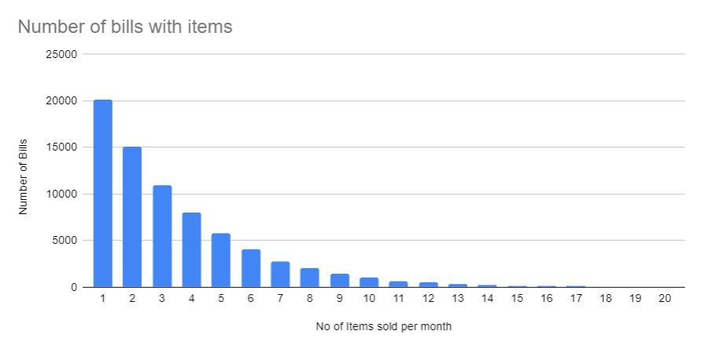
Data Analysis
Most of the customers are buying 1 item and leaving arcade shopping store. As we increase the number of items purchased in 1 bill, we can see a constant decrease in number of instances.
21% customers bought only 1 item
16% customers bought 2 items, and so on…

Slide 31
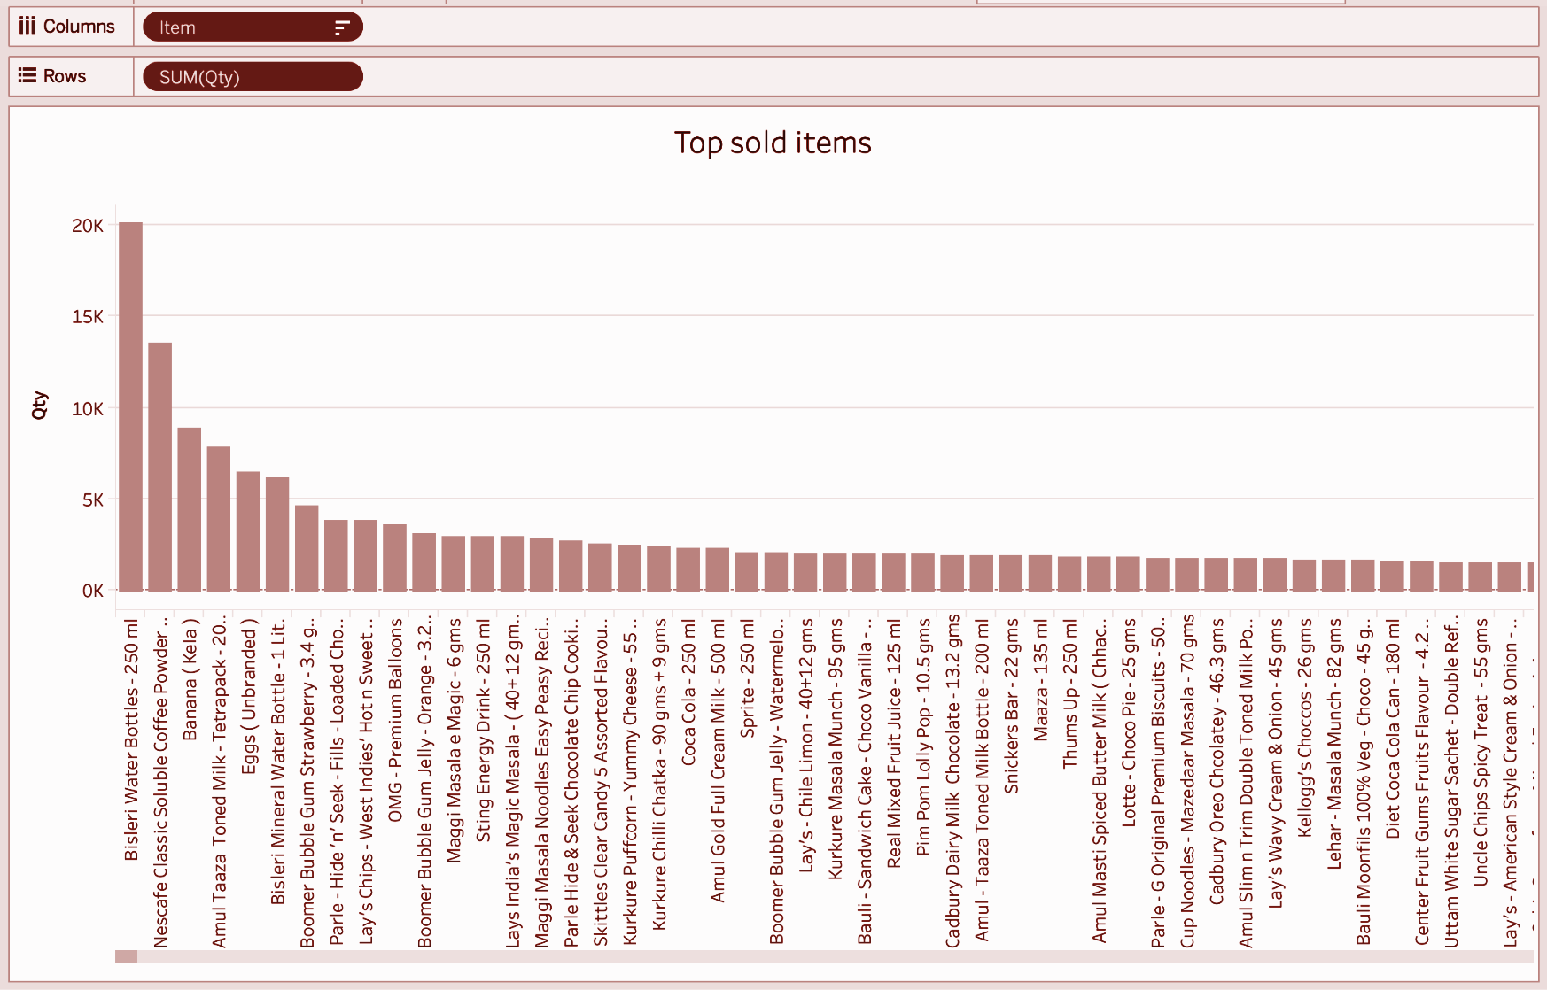
Data Analysis
We can observe that The top most sold items by quantity are:
Bisleri 250 ml water bottle
Nescafe Coffee powder sachets 2gm
Banana (Kela)
Amul taaza toned Milk 250ml
Eggs (unbranded)

Slide 32
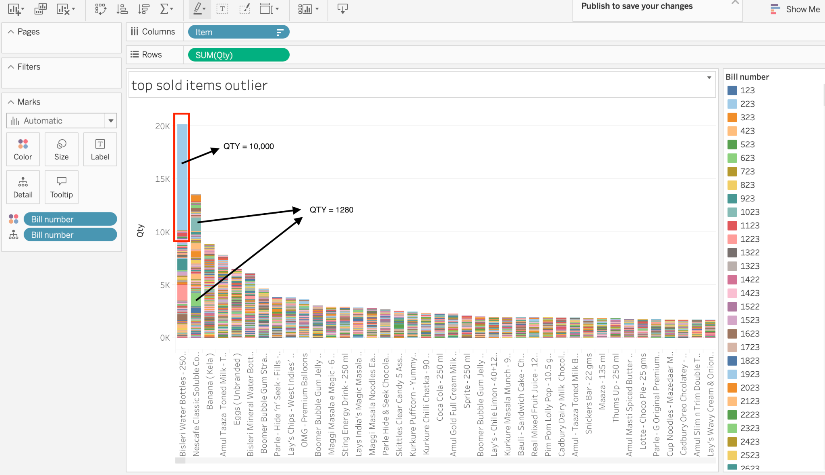
Data Analysis
On putting colour on bill number, we observed outliers in the data which were giving skewed results:
1 bill having 10000 bottles of bisleri 250ml
Multiple bills having exact 1280 Nescafe Coffee Sachets

Slide 33
Data Analysis : Inference
Inference
1 bill having 10000 bottles of bisleri 250ml : Bought by SNU for Convocation ceremony
Multiple bills having exact 1280 Nescafe Coffee Sachets: full packs of qty 1280 bought by students/ gym enthusiasts.

Slide 34
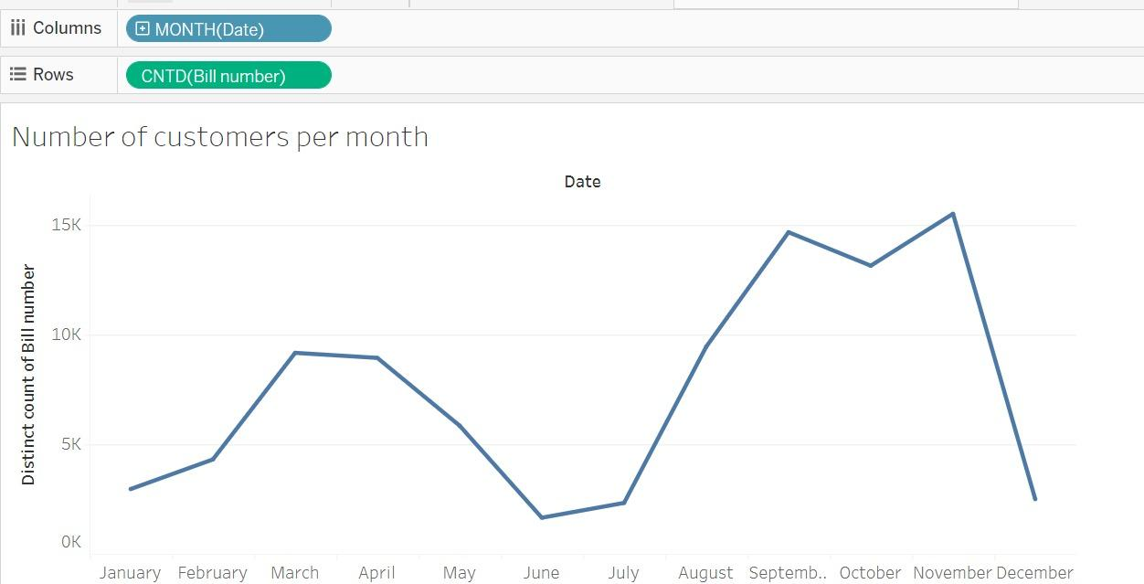
Data Analysis : Inference
Inference
Number of customers rose from the month of Jan to march as those were initial months of Arcade Grabbo store on SNU
There is a steep dip in number of customers from May to July as there are very few students on campus in those months
As students came back in August, the number of customers increased and at this time Grabbo added multiple new products in the store which further increased the customers.

Slide 35
RECOMMENDATIONS AND CONCLUSION
The retail industry's unspoken motto of cross-selling and upselling is what encourages customers to make larger purchases. For such companies, using market basket analysis in data mining to identify patterns and extract customer insights to improve the performance of their brands, has become a thriving component.
According to an urban tale, a grocery store saw an increase in sales after grouping beer and diapers together since a market basket analysis revealed that both products were frequently purchased by men.
Companies are gaining billions by manipulating client thought processes when they employ this strategy strategically. It is a practical strategy to increase sales without spending more time or money on marketing that won't yield the same amazing results. So go ahead and give it a try on all the data you have stored to find patterns that can completely surprise you.

Slide 36
ACKNOWLEDGEMENT
We would like to extend our sincere gratitude to Professor Vallurupalli Vamsi, School of Management and Entrepreneurship, Shiv Nadar University for providing us with the opportunity for taking this course and the project. We are thankful for his constant guidance throughout the course and pushing us to do better. We got a practical learning experience with the help of this project.

Slide 37
THANK YOU!

